Slide 1
Applicant Faking: Does it Exist, and is it Impacting Hiring/Interview Performance?
Jonah Garbin

Slide 2
Background
Interviews, particularly structured and Online Assessments are becoming influential in hiring decisions (Rothstein, Goffin 2006)
Two populations to talk about
Applicants: People applying
Have a higher incentive to fake interviews (Spector 2012)
Incumbents: Current Employees
Less incentive, as they are voluntary asked to complete an interview, and the results generally have no impact on their standing

Slide 3
Score Inflation Problem
Faking, done well, can produce “score inflation”, in which an applicant’s score is an overestimation of their true ability (Spector 2012)
Score inflation makes it difficult to find right applicants for the job (Spector, 2012)

Slide 4
Research Question
Is there a significant difference between fakers and non-fakers in interview performance (Cohen’s D)?
Are those who fake more likely to be hired (Odds Ratio)?
Could the interview one completes, or the setting of the study, change the effect of faking on interview performance?
Could the hiring ratio impact the effect of faking on hiring probability?

Slide 5
Searching Criteria
Studies need to be in English
Much be an Interview Related Setting (Either Laboratory or actual Job Applicant studies were accepted)
Predictor must be faking, and criterion must be interview performance/hiring rate
Results found 8 studies for Cohen’s D (67 Effect Sizes) and 4 Studies for Odds Ratio (20 Effect Sizes), and 2 studies which had both
The 4 Odds ratio studies were converted to have a Cohen’s D

Slide 6
Identification of new studies via databases
Identification of new studies via other methods
Identification
Records identified from:
Databases (k = 413)
Records removed before screening:
Duplicate records (k = 38)
Records identified from:
Citation searching (k = 15)
Screening
Records screened
(k = 398)
Records excluded
(k = 267)
Reports sought for retrieval
(k = 131)
Reports not retrieved
(k = 14)
Reports sought for retrieval
(k = 0)
Reports not retrieved
(k = 0)
Reports assessed for eligibility
(k = 117)
Reports assessed for eligibility
(k = 15)
Reports excluded:
Predictor Not Included (k = 18)
Criterion Not Included (k = 15)
Method (k = 55)
Sample (k = 17)
Records excluded:
Predictor Not Included (k = 1)
Criterion Not Included (k = 0)
Method (k = 12)
Sample (k = 0)
Included
Studies included from database review (k=12)
New studies included in review
(k = 2)

Slide 7
Coding & Reliability
Worked with Karen (she’s great!)
Several Variables Measured (because I was confused); far more than listed below
Important Variables:
Mean Age of Participants
Percent Female of Participants
Was Study US Conducted?
What interview was Used in the Study?
Effect Size Values
Karen and I met outside of class to discuss the outline of the codebook as well as logistics on how to code particular variables
Results show high inter-rater reliability (90.5%)
Notes:
99.5% agreement on all Important Variables

Slide 8
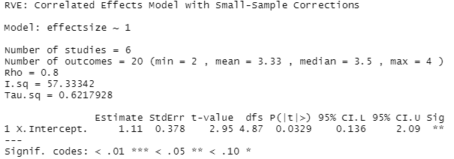
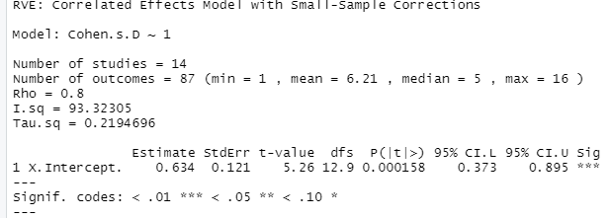
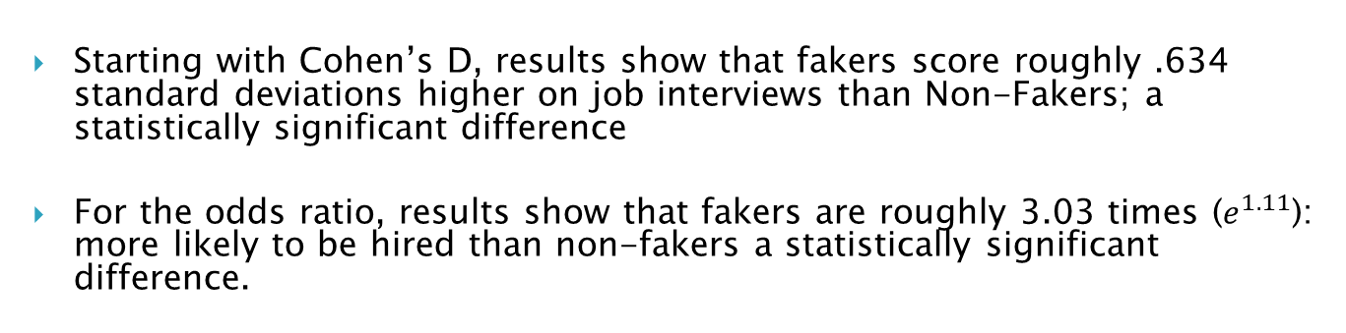
Results (Base)
95% PI: -.42 – 1.70
95% PI: .10 – 11.82
Starting with Cohen’s D, results show that fakers score roughly .634 standard deviations higher on job interviews than Non-Fakers; a statistically significant difference
For the odds ratio, results show that fakers are roughly 3.03 times ($e^{1.11}$): more likely to be hired than non-fakers a statistically significant difference.

Slide 9
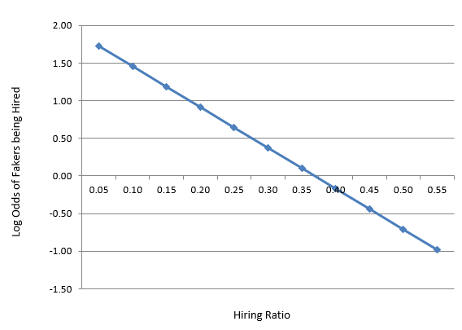
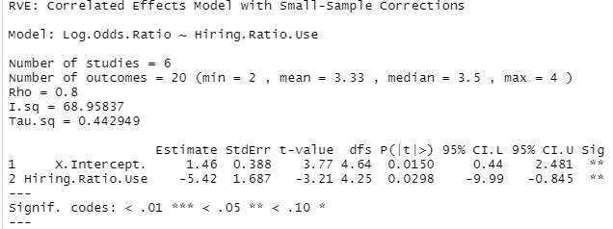
Results (Odds Ratio Moderator)
One moderator including: Hiring ratio (proportion of individuals that will be hired)
Results find that hiring ratio is a significant, negative moderator of faking’s effect on the probability of hiring!!

Slide 10
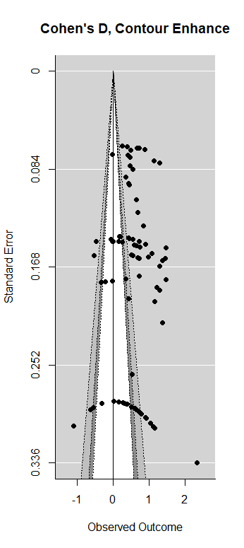
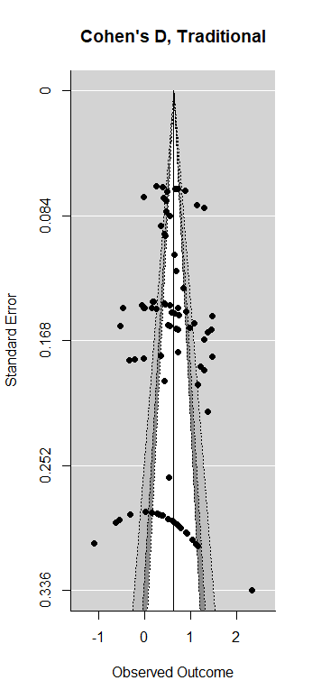
Results (Publication Bias)
Considering the plots, we see there are some slight gaps in smaller studies for both positive and negative effects
Overall, Sides look relatively symmetrical

Slide 11
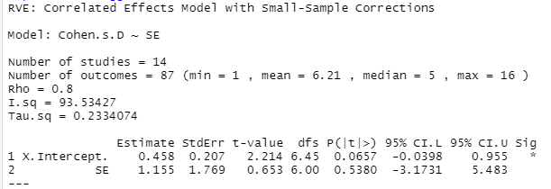
Results (Publication Bias)
Results show from the Egger test, that standard error is not a significant moderator of either effect size, although, it goes from being statistically significant to “marginally significant”
This result, like the Funnel Plot, gives more evidence of publication bias being less significant in this particular in this study

Slide 12
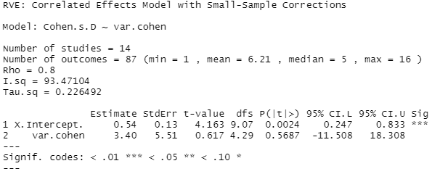
Results (Publication Bias)
Because the intercept was “marginally significant” (one marginal), a PEESE test was conducted
Results show no significant moderation of variance on either effect size; indication of further evidence of publication bias being less likely

Slide 13
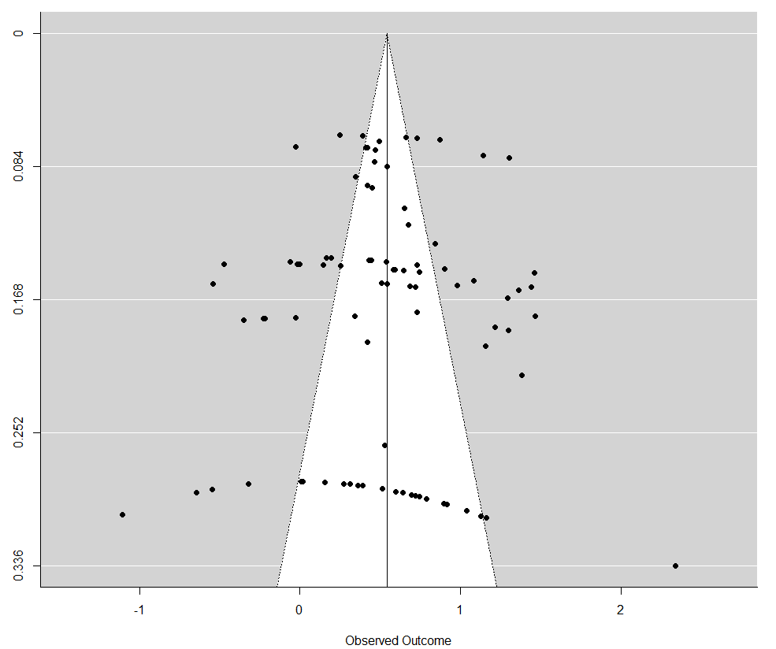
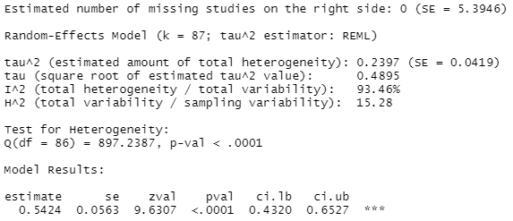
Trim and Fill Plot
We see a slight decrease in the effect size (.643 to .542), but overall, this indicates further evidence of publication bias being less apparent

Slide 14
Conclusion
Fakers are doing better on interviews than Non-fakers; a further incentive for applicants to want to fake on job hiring interviews/assessments
We should absolutely be concerned with faking on interviews
This has been a subject of much debate, hopefully this helps clarify the answer
There has been significant amounts of work trying to reduce faking, although the methods have shown mixed results
I think I might have a solution! (Dissertation!!)

Slide 15
Limitations
Only using published work
Most dissertations and others were focused on reducing faking, not showing it exists
Wish I had more studies to work with…
Most studies using Big 5 Personality Inventory
While Big 5 is still prominent in interviewing scenarios, most are stepping away, and using created researched interviews

Slide 16
References
Bowman, N. A. (2012). Effect sizes and statistical methods for meta-analysis in higher education. Research in Higher Education, 53(3), 375-382.
Rothstein, M. G., & Goffin, R. D. (2006). The use of personality measures in personnel selection: What does current research support?. Human Resource Management Review, 16(2), 155-180.
Spector, P. E. (2012). Self-Reports for Employee Selection. In The Oxford Handbook of Personnel Assessment and Selection (pp. 443-461). New York, NY: Oxford University Press.
Tanner‐Smith, E. E., & Tipton, E. (2013). Robust variance estimation with dependent effect sizes: Practical considerations including a software tutorial in Stata and SPSS. Research synthesis methods, 5(1), 13-30.

